Slide 1
Data Structures Algorithm and Design SSZG519
Mr. Chennupati R Prasanna

Slide 2
SSZG519-Dynamic Programming

Slide 3
Those who cannot remember the past are condemned to repeat It
-Dynamic Programming

Slide 4
Dynamic Programming History
Bellman. Pioneered the systematic study of dynamic programming in the 1950s.
Etymology.
Dynamic programming = planning over time.
Secretary of Defense was hostile to mathematical research.
Bellman sought an impressive name to avoid confrontation.
"it's impossible to use dynamic in a pejorative sense"
"something not even a Congressman could object to"
Notes:
Reference: Bellman, R. E. Eye of the Hurricane, An Autobiography.

Slide 5
Introduction
Dynamic Programming(DP) applies to optimization problems in which a set of choices must be made in order to arrive at an optimal solution.
As choices are made, subproblems of the same form arise.
DP is effective when a given problem may arise from more than one partial set of choices.
The key technique is to store the solution to each subproblem in case it should appear

Slide 6
Introduction (cont.)
Divide and Conquer algorithms partition the problem into independent subproblems.
Dynamic Programming is applicable when the subproblems are not independent.(In this case DP algorithm does more work than necessary)
Dynamic Programming algorithm solves every subproblem just once and then saves its answer in a table.

Slide 7
Dynamic Programming Applications
Areas.
Bioinformatics.
Control theory.
Information theory.
Operations research.
Computer science: theory, graphics, AI, systems, ….
Some famous dynamic programming algorithms.
Viterbi for hidden Markov models.
Unix diff for comparing two files.
Smith-Waterman for sequence alignment.
Bellman-Ford for shortest path routing in networks.
Cocke-Kasami-Younger for parsing context free grammars.

Slide 8
The steps of a dynamic programming
Characterize the structure of an optimal solution
Recursively define the value of an optimal solution
Compute the value of an optimal solution in a bottom-up fashion
Construct an optimal solution from computed information

Slide 9
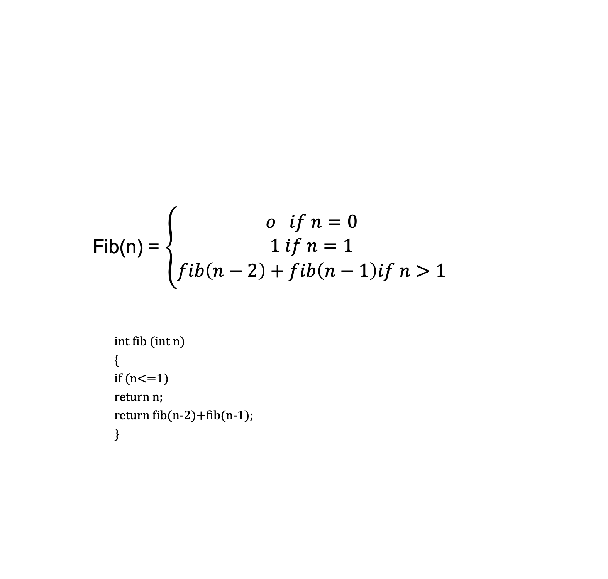
Fibonacci Number
Fib(n) = $\left\{\begin{aligned}o if n=0 \\ 1 if n=1 \\ fib\left(n−2\right)+fib\left(n−1\right)if n>1\end{aligned}\right.$
int fib (int n)
{
if (n<=1)
return n;
return fib(n-2)+fib(n-1);
}

Slide 10
Fibonacci Number (cont..,)
int fib (int n)
{
if (n<=1)
return n;
return fib(n-2)+fib(n-1);
}
Fib(5)
Fib(3)
Fib(1)
Fib(4)
T(n) =2T(n-1) +1
Use master theorem = O(2^{n})
Fib(2)
Fib(2)
Fib(3)
Fib(0)
Fib(1)
Fib(0)
Fib(1)
Fib(1)
Fib(2)
Fib(0)
Fib(1)

Slide 11
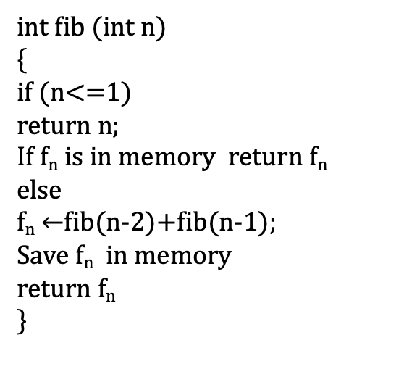
Recursion with Memoization
Fib(5)
int fib (int n)
{
if (n<=1)
return n;
If f_{n} is in memory return f_{n}
else
f_{n} $←$fib(n-2)+fib(n-1);
Save f_{n} in memory
return f_{n}
}
Fib(3)
Fib(1)
Fib(4)
Fib(2)
Fib(2)
Fib(3)
Fib(0)
Fib(1)

Slide 12
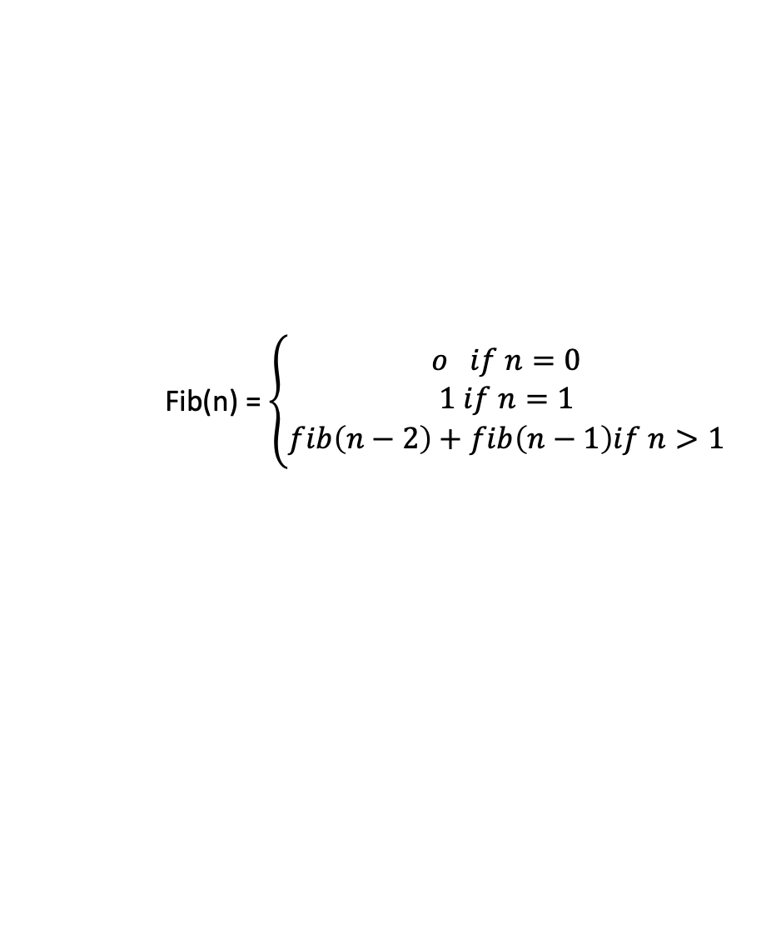
Table method or iterative method
F
Fib(n) = $\left\{\begin{aligned}o if n=0 \\ 1 if n=1 \\ fib\left(n−2\right)+fib\left(n−1\right)if n>1\end{aligned}\right.$
0
1
2
3
4
5
Fib(5)
int fib (int n)
{
if (n<=1)
return n;
f[0] =0; f[1] =1;
For (int i=2;i<=n;i++)
{
f[i] =f[i-2]+f[i-1];
}
return f[n];
}
Fib(3)
Fib(4)
$${∶ \atop ∶}$$
$${∶ \atop ∶}$$

Slide 13
Thank You!!

